Slide 1

Introduction to Python - Part 1
Variables, Data Types and The Print Function

Slide 2
Introduction

Slide 3

Jupyter Environment
The Jupyter Notebook is a web-based application suitable for developing, documenting, and executing code, as well as communicating the results
The Jupyter notebook combines two components:
A web application
Notebook documents

Slide 4
Jupyter Environment
A web application is a browser-based tool for intuitive creation of documents which combine explanatory text, mathematics, computations and their rich media output
Notebook documents is a representation of all content visible in the web application, including informative content like explanatory text, inputs and outputs of the computations, mathematical equations, images, etc.

Slide 5
Jupyter Environment
It can be used for over 40 programming languages. It is mainly used for Python, R, Julia and Scala within the data science community
You can also use Jupyter with big data frameworks, like Apache Spark with Python, R and Scala

Slide 6
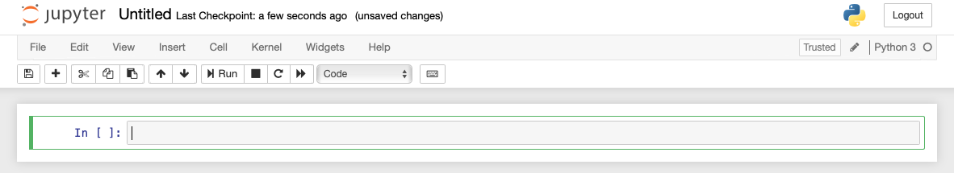
Jupyter Editor
Click here to change the name of the notebook
Menu bar
Write your code here
Running Python Kernel

Slide 7
Variables

Slide 8
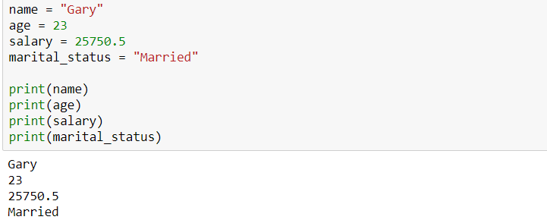
Variables
Variables are reserved memory that store data.
Unlike languages like C, C++ and Java, Python has no command for declaring variable
= operator is used to assign a value to a variable

Slide 9
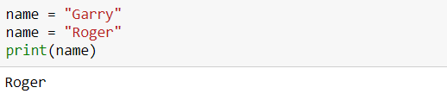
Reassigning Variables
We would only receive the second assigned value as the output since that was the most recent assignment

Slide 10
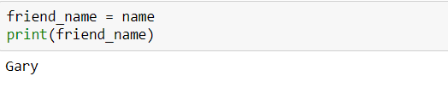
Reassigning Variables
You can connect a different value with a previously assigned variable very easily through simple reassignment

Slide 11
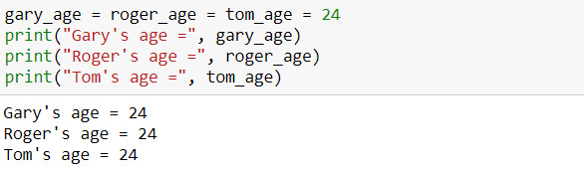
Multiple variable assignment
With same value

Slide 12
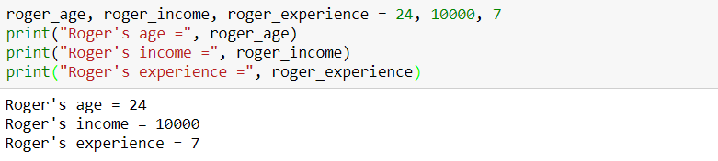
Multiple variable assignment
With different values

Slide 13
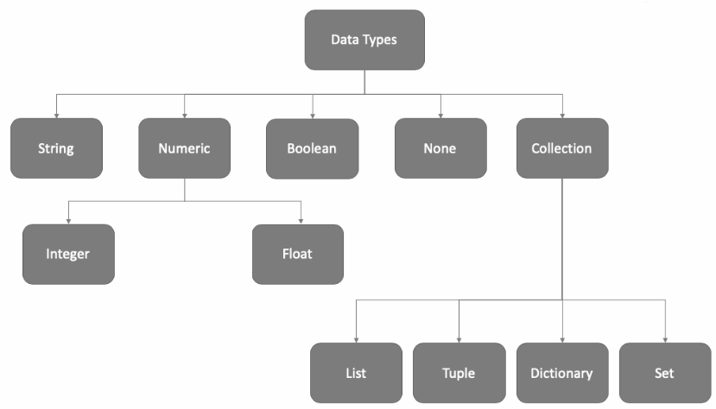
Data Types in Python

Slide 14

We learn the following data types today

Slide 15
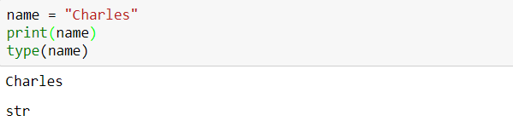
Creating string variables
String variables are variables that hold zero or more characters such as letters, numbers, spaces, commas and many more
Use type(variable_name) to check the data type of variable declared

Slide 16
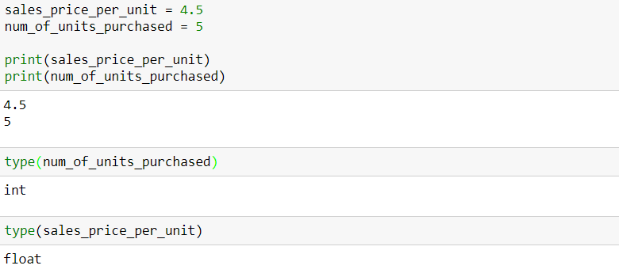
Creating numeric variables
A numeric variable is one that may take on any value within a finite or infinite interval
As seen earlier, there are two types of numeric data types:
integer
float

Slide 17
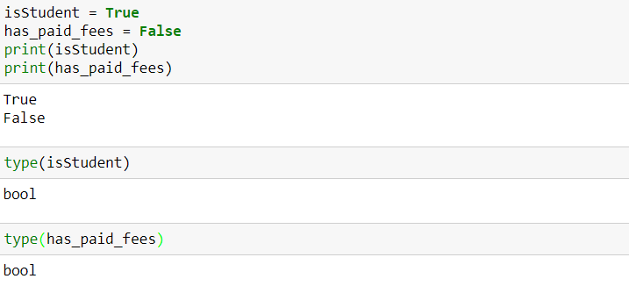
Creating boolean variables
Boolean variables are variables that can have only two possible values: true and false

Slide 18
Data type conversion
Python supports conversion of one data type to another
Type Conversion
Implicit Conversion
Explicit Conversion

Slide 19
Data type conversion
Python supports conversion of one data type to another
Implicit Conversion: Conversion done by Python interpreter with programmer’s intervention
Explicit Conversion: Conversion that is user-defined that forces an expression to be of specific data type
Type Conversion
Implicit Conversion
Explicit Conversion
Arithmetic Operation
Casting Operation

Slide 20
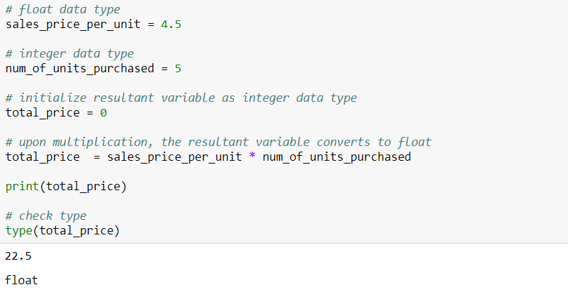
Implicit conversion
In implicit conversion, the conversion is done by Python interpreter with programmer’s intervention

Slide 21
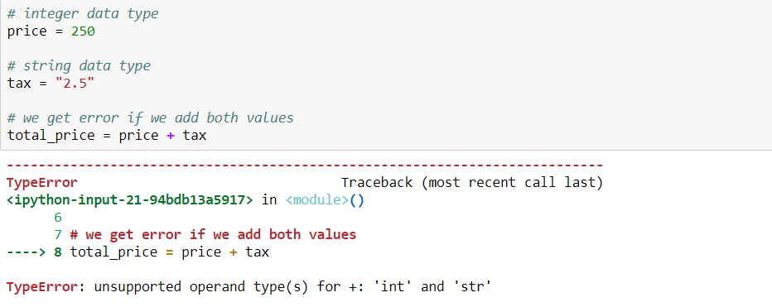
Explicit conversion
In explicit conversion, the conversion is done by Python interpreter with programmer’s intervention. Consider the following example:

Slide 22
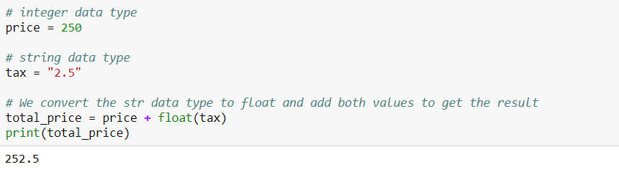
Explicit conversion
Explicit data type conversion using float() function

Slide 23
Type casting
Type Casting
int()
float()
bool()
str()

Slide 24
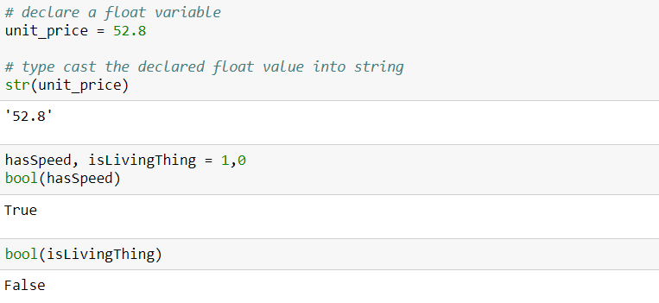
Type casting

Slide 25
What are functions?

Slide 26
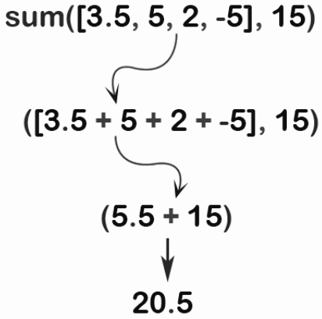
What are functions?
A function is a block of reusable code that runs when called
A function has a name. You call the function by its name
A function can take input(s), known as input parameters
A function can return data as a result
Function name: sum()
Input parameters
Return value of the function

Slide 27
What are functions?
There are three types of functions:
Built-in Functions
User-defined Functions
Lambda Functions
Some of the built-in functions are: print() - to print the output, input() - to take input from user, the type casting functions like int(), float(), str(), bool(), etc
We will study the user-defined functions and lambda functions in details in our last session

Slide 28
The print() Command

Slide 29
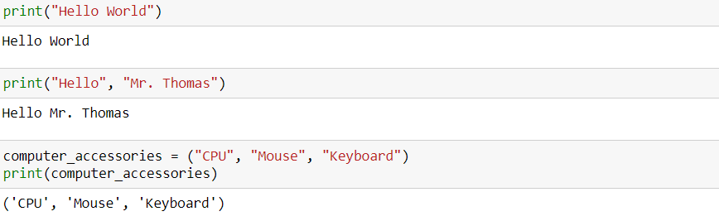
The print() in python
The print() function prints the specified message to the screen
The message can be a string, or any other object
The object will be converted into a string before written to the screen
strings separated by a comma within a print() function get concatenated.

Slide 30
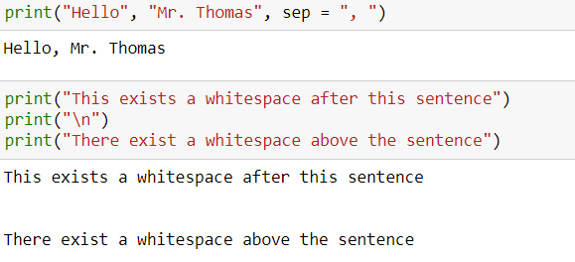
The print() in python
The sep is an optional parameter. When output is printed, each word is separated by comma and space character
print(‘\n’) gives a new blank line
The backslash “\” is a special character that represents whitespaces. For example ‘\t’ is a tab and ‘\n’ is a new line.

Slide 31

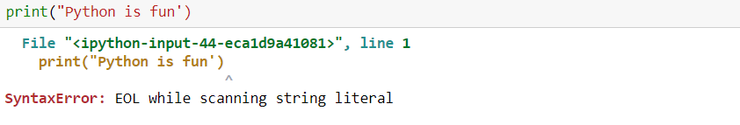
Invalid use of opening and closing quotes is not allowed

Slide 32
Concatenation using print()
Use + operator to concatenate two strings

Slide 33
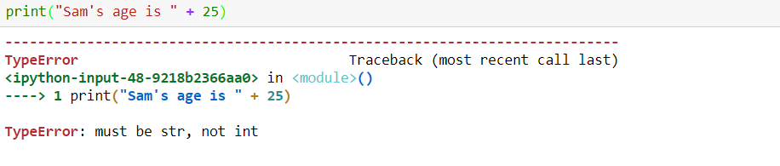
You cannot concatenate string & number
Adding numbers to strings does not make any sense. Please consider explicit conversion to convert the number to string first, in order to join them together.

Slide 34
Concatenating with type casting
Explicit conversion of a number to string with str() function.
We learn more such type conversions in our upcoming sessions

Slide 35
THANK YOU
Presenter’s Name
Contact Us
support@knowledgehut.com
Presenter’s Designation

